Slide 1
Introduction to Computer Science (371-1-1601)
Lectures by: Dr. Dan Vilenchik & Dr. Zion Siksik
Recitations by: Ariel Cohen, Moshiko Davidian, Assaf Livne, Yair Mazal

Slide 2
Recitation 6 Error handling

Slide 3
Today's topics
Testing, debugging
Error handling
HW1 code review

Slide 4

Testing and debugging
What are “bugs” ?
How can we debug them?

Slide 5
Testing and debugging
What are “bugs” ?
Computer programs flaws, mistakes, errors
How can we debug them?

Slide 6
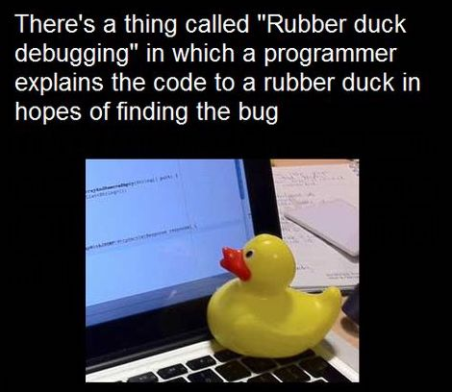
How can we debug?
Don’t Panic

Slide 7
How can we debug?
The process of debugging is circular, clearing one bug can reveal another:
Think
Write unit tests
Investigate variables ( debugger/ print)
Tips: Reduced problem, minimal iteration, manipulate the variables to find the problem

Slide 8
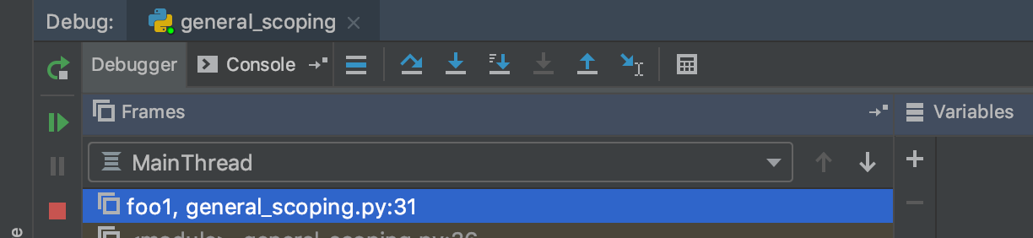
Debugger tools
Step over
Rerun
Step into
Step out
Resume
Stop

Slide 9
Class Example – Explain the code
def code_letters(str1, coding_dict, letter): str1.replace(letter, coding_dict[letter]) def abra(str1, dict1): for i in range(len(str1)): code_letters(str1, dict1, str1[i]) return str1 def kadabra(code): t = {chr(i): chr(i + code) for i in range(ord('a'), ord('z') + 1 )} t.update({chr(ord('z') - i): chr(code - i -1 + ord('a')) for i in range(code)}) return t
d = kadabra(5) print(abra("abrakadabra", d))

Slide 10
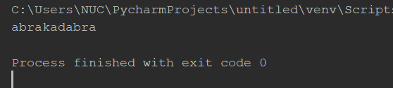
Class Example – can you find the problem?
def code_letters(str1, coding_dict, letter): str1.replace(letter, coding_dict[letter]) def abra(str1, dict1): for i in range(len(str1)): code_letters(str1, dict1, str1[i]) return str1 def kadabra(code): t = {chr(i): chr(i + code) for i in range(ord('a'), ord('z') + 1 )} t.update({chr(ord('z') - i): chr(code - i -1 + ord('a')) for i in range(code)}) return t
d = kadabra(5) print(abra("abrakadabra", d))

Slide 11
Error Handling : Try - except
What can we do with run time errors?
def divide_numbers(): d = input('Please enter the denominator: ') n = input('Please enter the numerator: ') print('The result is: ' + str(int(n)/int(d)))

Slide 12
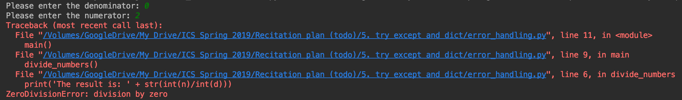
Error Handling : Try - except
def divide_numbers(): d = input('Please enter the denominator: ') n = input('Please enter the numerator: ') print('The result is: ' + str(int(n)/int(d)))

Slide 13
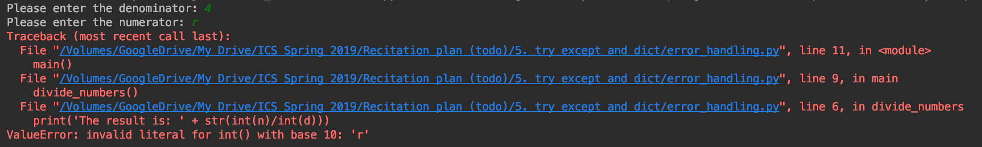
Error Handling : Try - except
def divide_numbers(): d = input('Please enter the denominator: ') n = input('Please enter the numerator: ') print('The result is: ' + str(int(n)/int(d)))

Slide 14
Error Handling : Try - except
We can use the try-except mechanism to “catch” the error and respond accordingly.
def divide_numbers_safe(): while True: try: d = input('Please enter the denominator: ') n = input('Please enter the numerator: ') print('The result is: ' + str(int(n)/int(d))) return except ValueError: print("\nPlease enter a number!! \n")

Slide 15
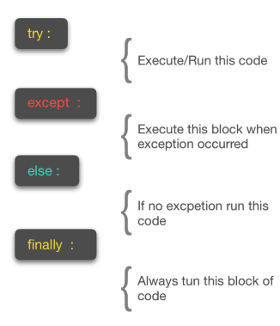
Error Handling : Try - except
We can also use “raise” to create an exception, which can be caught by this mechanism

Slide 16
HW1 Code review
What is code review?
The below presented code is shown to shame any one, it is shown for all of us to learn from.

Slide 17
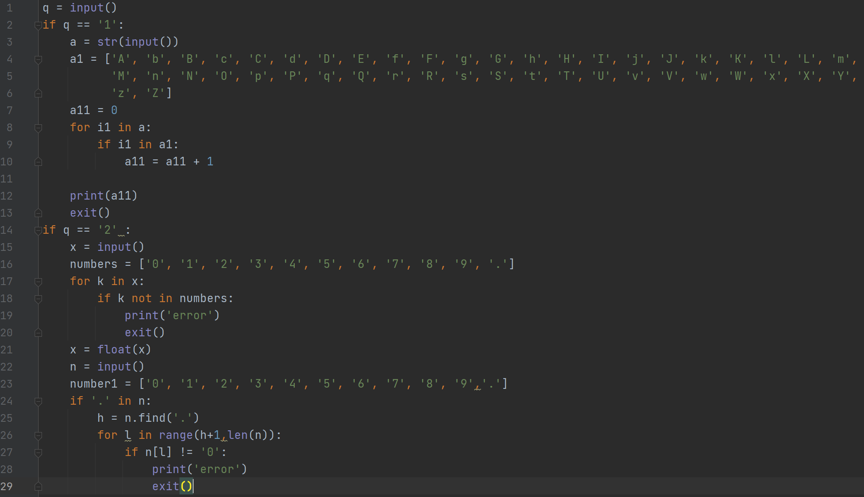
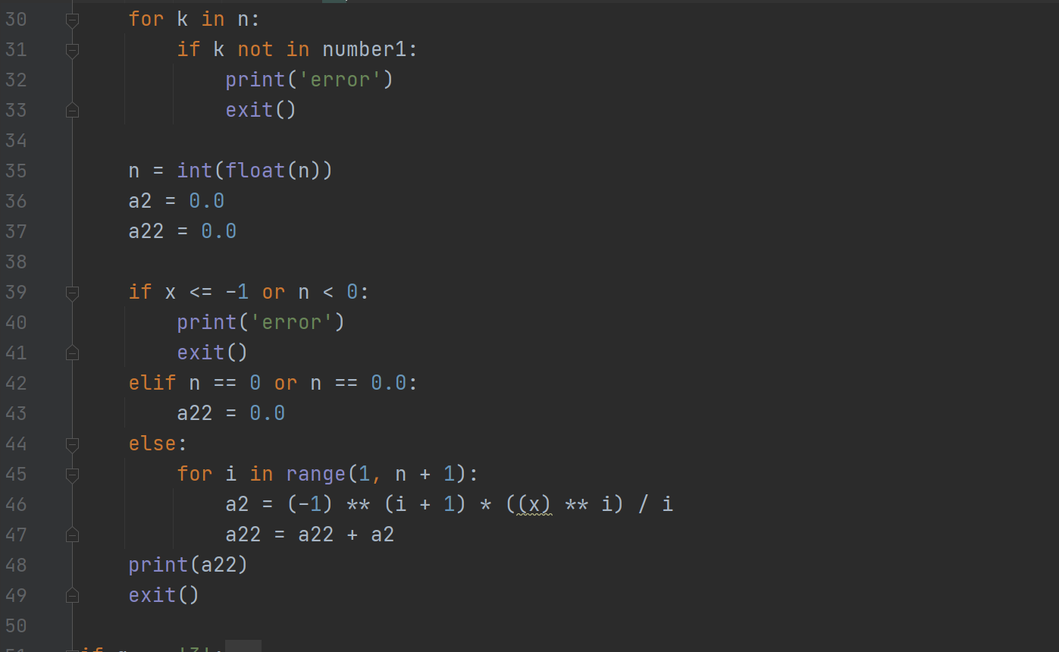
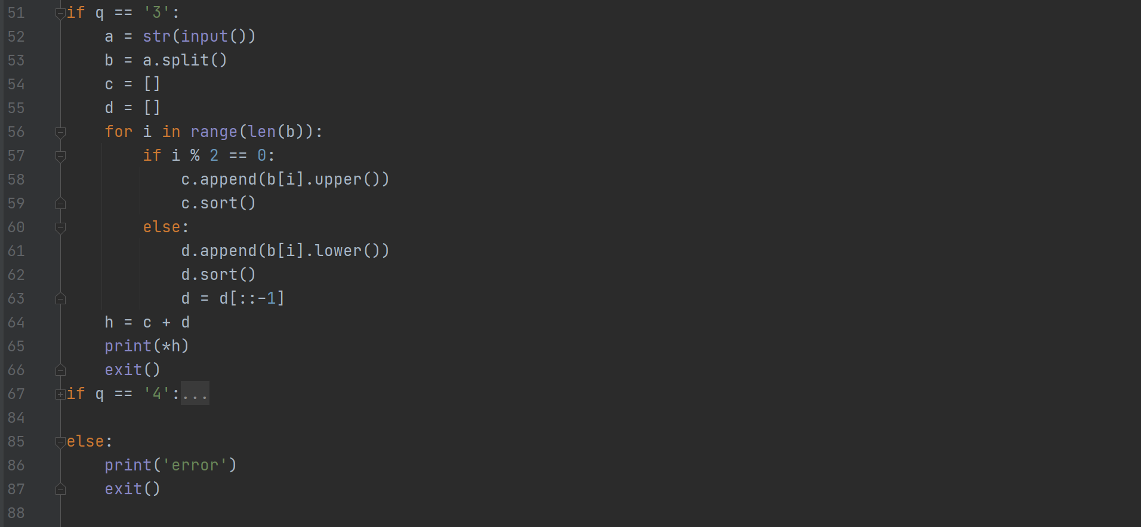
Example 1 – Can you explain how the students solve q2?
Notes:
Missing zeroth term on expansion, unreadable code makes debugging harder.
Add comments and use meaningful names.

Slide 18
This isn’t very pythonic
Can you find the bug?
Example 1 – Can you explain how the students solve q2?
What these variables do?
This isn’t very pythonic
Notes:
There are better ways to do this. Why not use string built in method?
Why iterate over indices and not values?

Slide 19
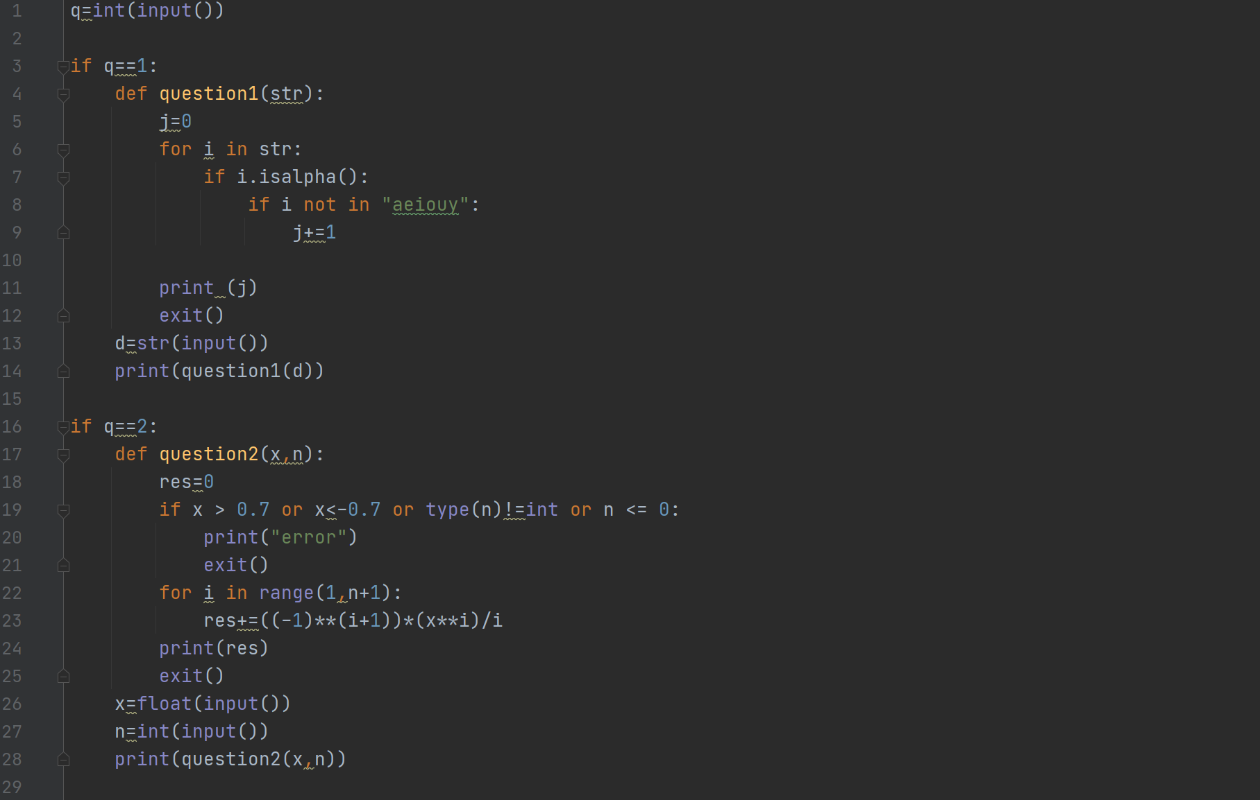
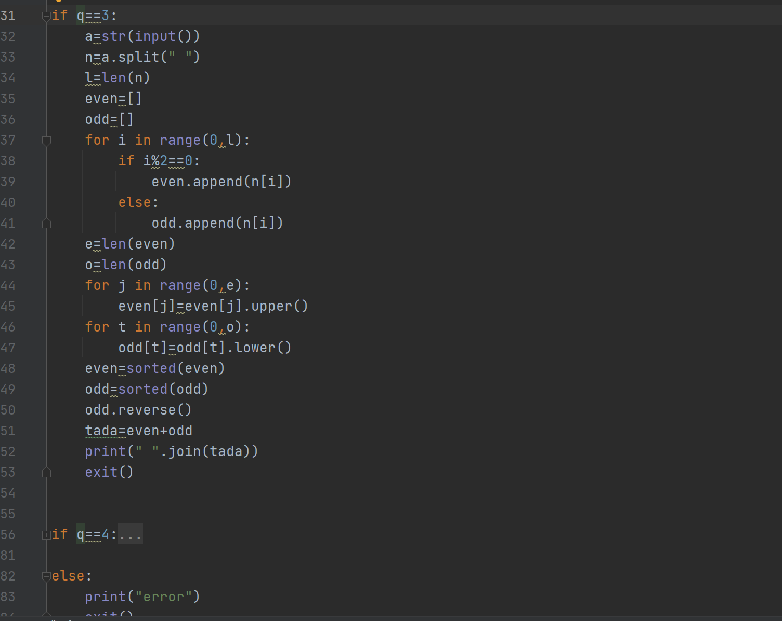
Example 2 – What will be printed from the two marked lines?
Notes:
These don’t really print anything

Slide 20
Example 2 – Can you explain how the students solve q2?
Comments? Docstrings? Hinting? Variables names?
This isn’t very pythonic

Slide 21
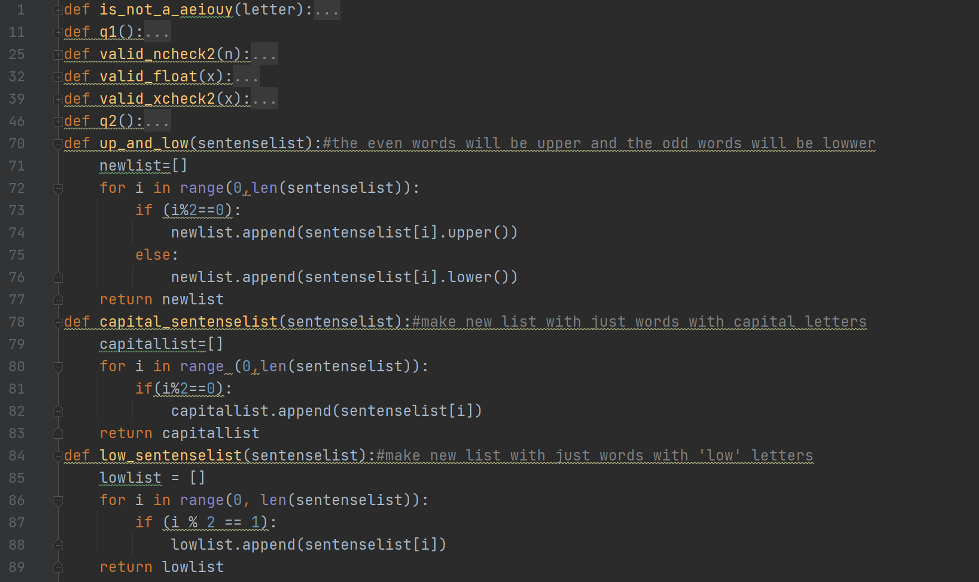
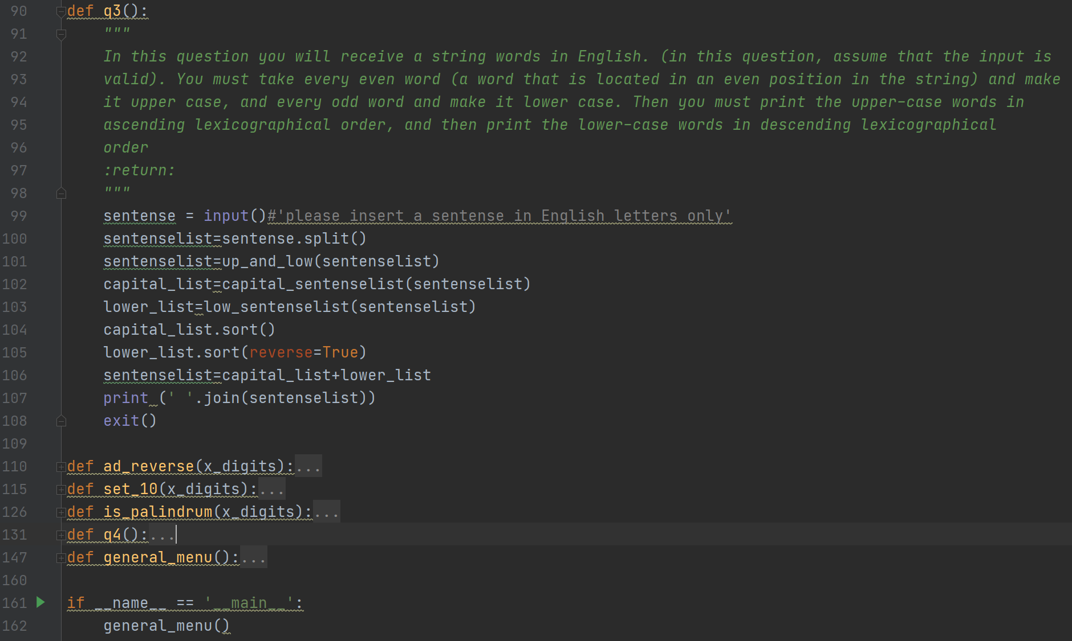
Example 3 – In Q3 how many times the program loops over the sentence?
Notes:
Way to much functions, but well documented kinda. Also here we can find a not very pytonic loops. But try to find out how many times q3 loops over the same sentence

Slide 22
Example 3 – In Q3 how many times the program loops over the sentence?

Slide 23
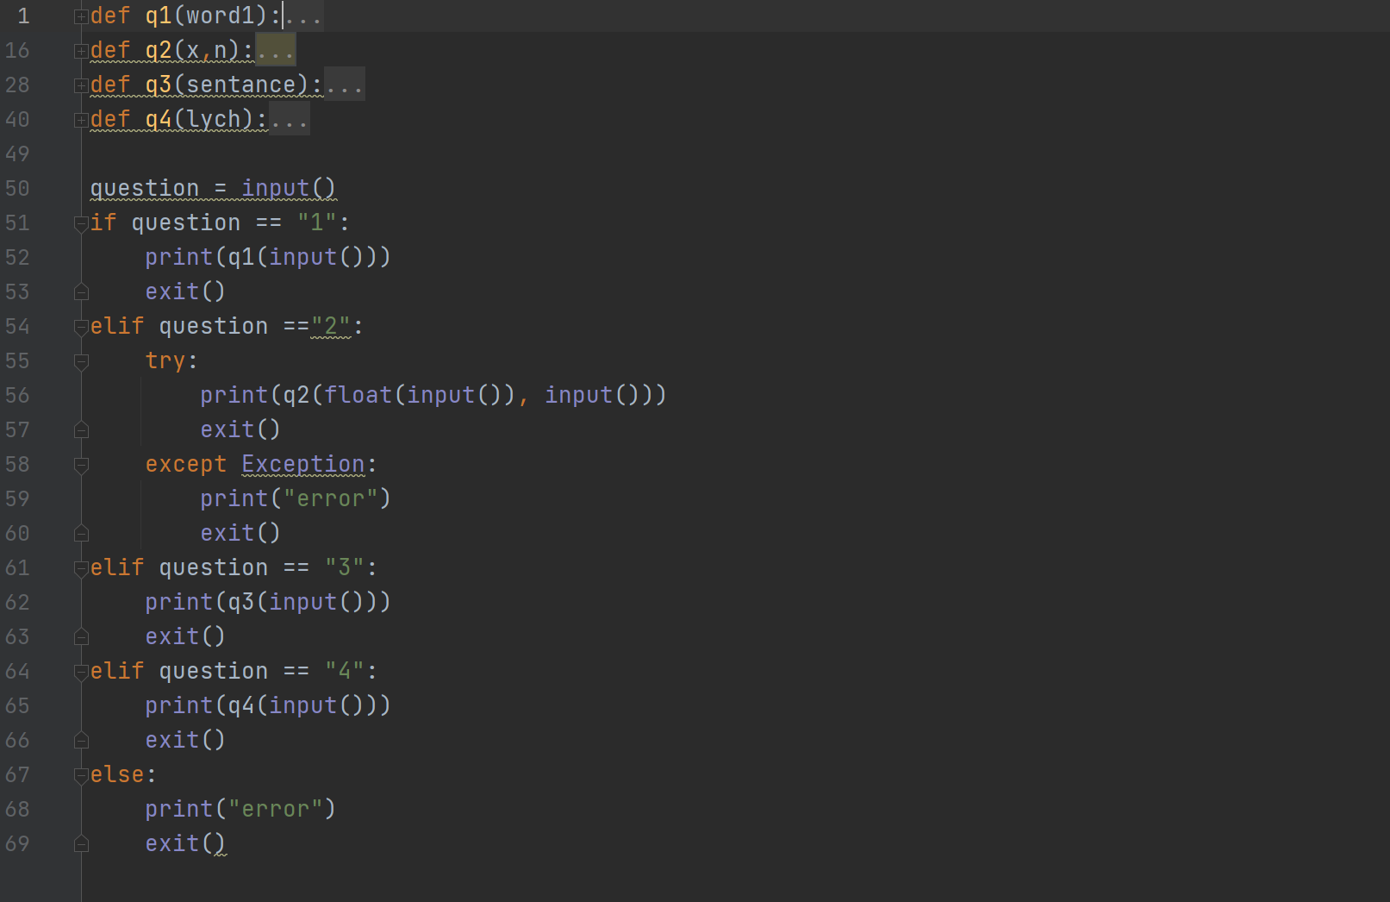
Example 4 – Why am I showing this?
Notes:
Way to much functions, but well documented kinda. Also here we can find a not very pytonic loops. But try to find out how many times q3 loops over the same sentence

Slide 24
Example 4 – Why am I showing this?
!!!!!!!!!!!!!!!!!!!!!!!!!!!!!!!!!!!!!!!!!!!!!!!!!!!
Notes:
Way to much functions, but well documented kinda. Also here we can find a not very pytonic loops. But try to find out how many times q3 loops over the same sentence

Slide 25
Summary
We saw today how to use:
How to raise and handle exceptions
HW1 code review

